Slide 1



ICT in Building Design
Optimization and prediction of the energy consumption of a school building in Turin
Professors:
Giacomo Chiesa
Lorenzo Bottaccioli
Authors:
Arman Mohammadigilani
Mohammad Eftekhari Pour
Hossein Zahedi Nezhad
Setareh Pourgholamali
Ali Mohammad Alizadeh
Team 4

Slide 2

Table of contents
01.
Overview
02.
Surrogate Model
03.
Data Dashboard
04.
Energy Signature
05.
Prediction
2

Slide 3

1
Overview
3

Slide 4

Objectives
Improve the energy efficiency of the school building in Turin:
Optimize the IDF (Input Data File) using a Surrogate Design Optimization model through DesignBuilder for enhanced energy efficiency in Turin's school building.
Implement intelligent control strategies for virtual monitoring of the building's behavior, utilizing real-time data and feedback.
Optimize energy management to improve overall efficiency.
4

Slide 5



System Framework
IDF
Design of Experiment
Surrogate Model Deployment
Parameter Optimization
Optimized
IDF
EPW
Surrogate Design Optimization
5

Slide 6



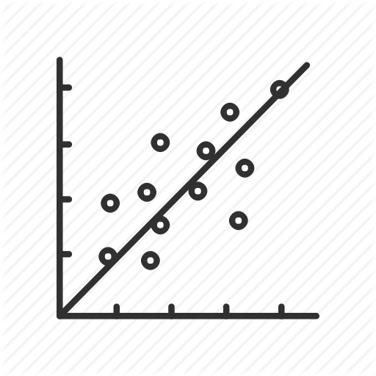


System Framework
Data Storage and Dashboard
Optimized
IDF
Sensors
Actuator
EPW
Energy Signature
Prediction Algorithm
Device Connector
Stepped Simulation with I/O
Building Management System
6

Slide 7
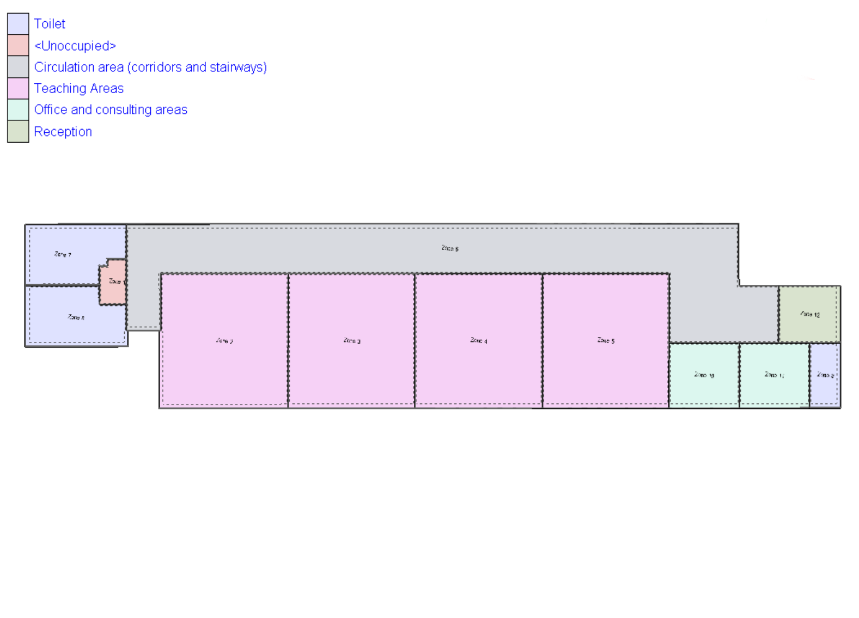
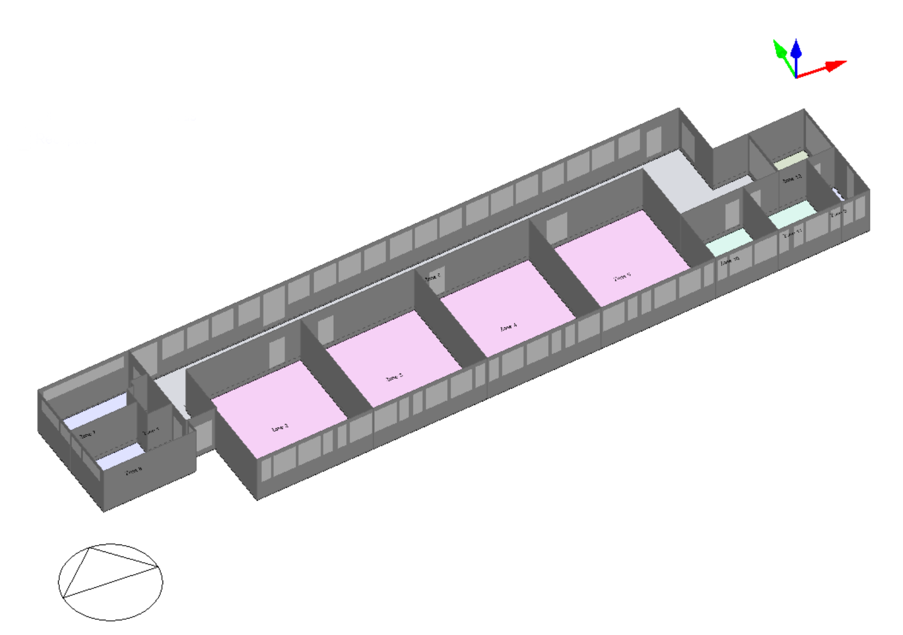
DesignBuilder
Type | School
Location | Turin
Details | 4 Classrooms, 2 Offices, 3 Toilets, 1 Corridor, 1 Storage Room, 1 Reception Room
Specified Parameters
Window Type: Double Glazing
CoolingFuel: Electricity from grid
Illuminance: 500 lux
Cooling Set Point: 26-30
Lighting: LED
Heating Fuel: Natural Gas
Radiant_Visible fraction: 0.420-0.180
Heating Set Point: 16-20
schedule: 7:00-18:00 (Monday-Friday)
Humidification set points: 30-50 %
Ventilation: ON
7

Slide 8
2
Surrogate Model
8

Slide 9
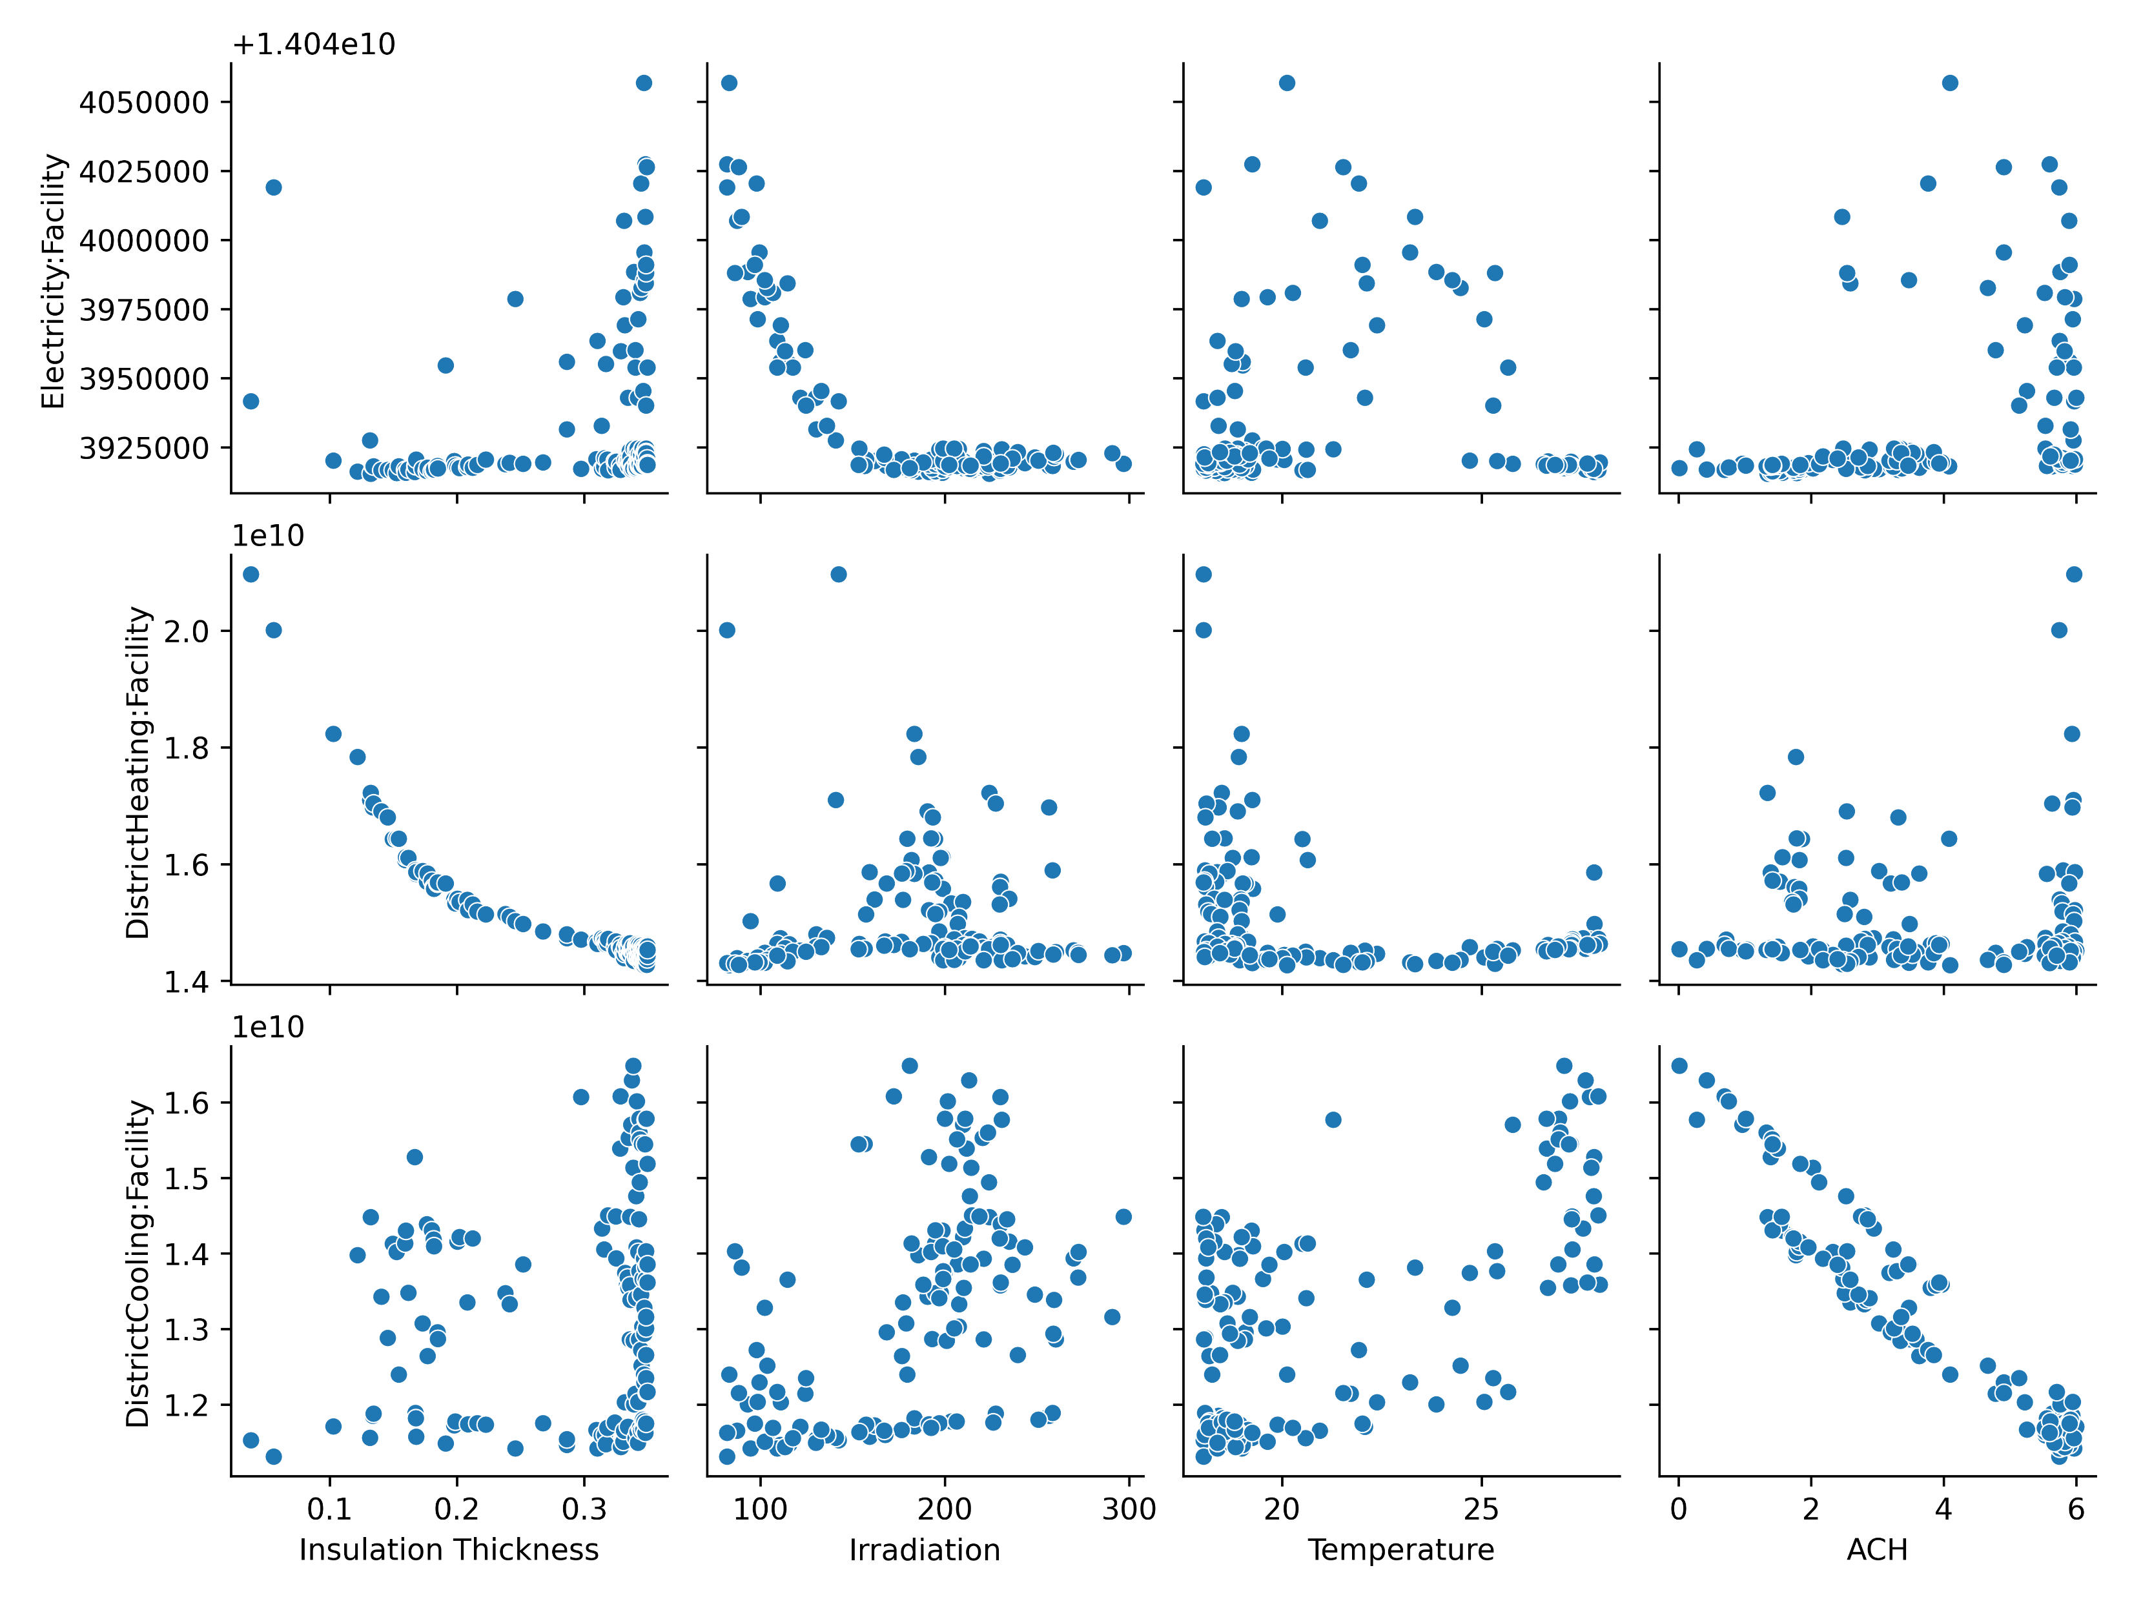
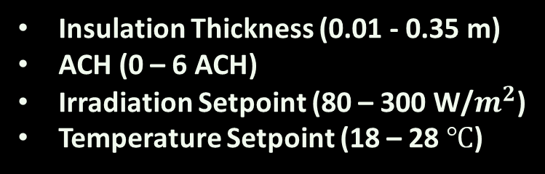
Surrogate Model Sampling
Create 100 samples using different combinations of the following 4 parameters using the IDF and EPW files:
Insulation Thickness (0.01 - 0.35 m)
ACH (0 – 6 ACH)
Irradiation Setpoint (80 – 300 W/$m^{2}$)
Temperature Setpoint (18 – 28 $℃$)
Objectives:
District Heating
District Cooling
Electricity Facility
9

Slide 10
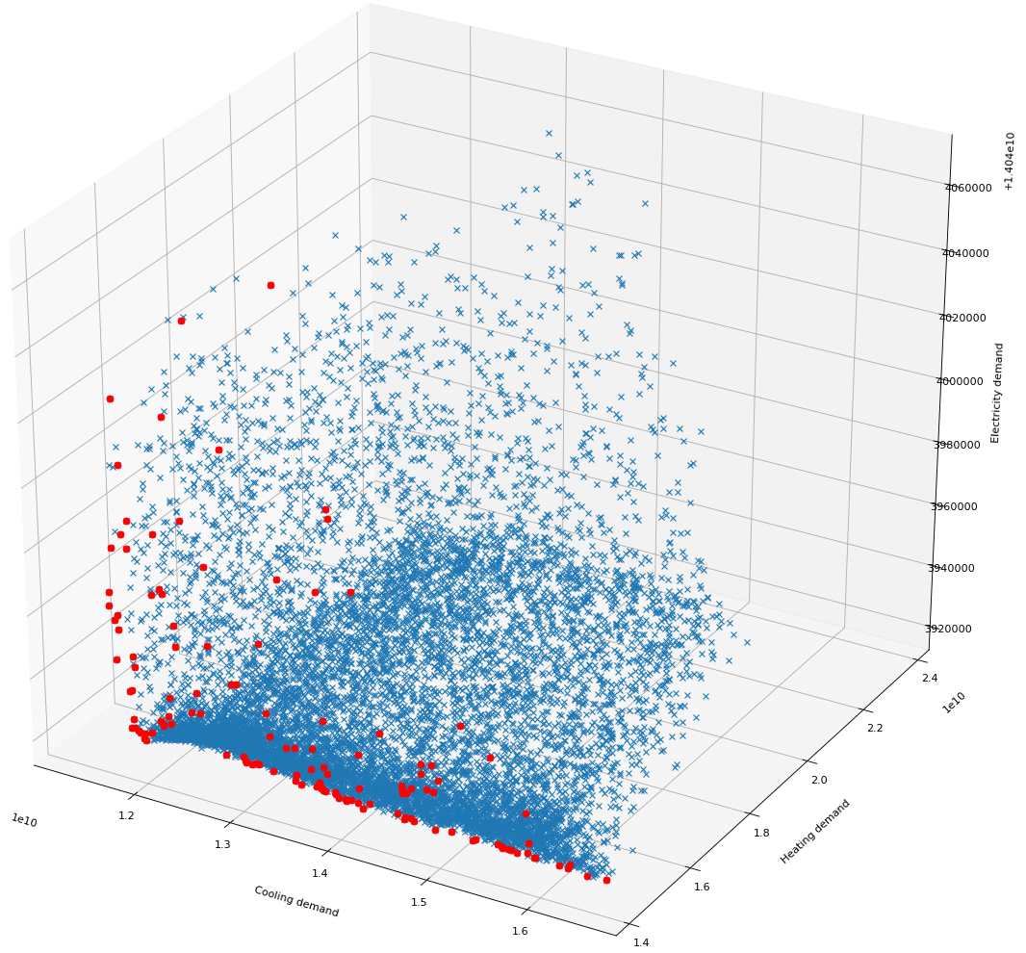
3D Analysis of Electricity vs. Heating and Cooling Demands
Data Distribution:
Blue Crosses: Spread along cooling and heating axes; tighter clustering on electricity axis.
Implication: Building design/operation impacts heating/cooling more than electricity.
Pareto Optimal Points (Red Dots):
Located primarily at lower values for all energy demands.
Significance: Efficient configurations minimize all energy types simultaneously.
Trends and Trade-offs:
Non-linear correlation between cooling/heating and electricity demands.
Potential: Reducing heating/cooling could proportionally decrease electricity usage.
10

Slide 11
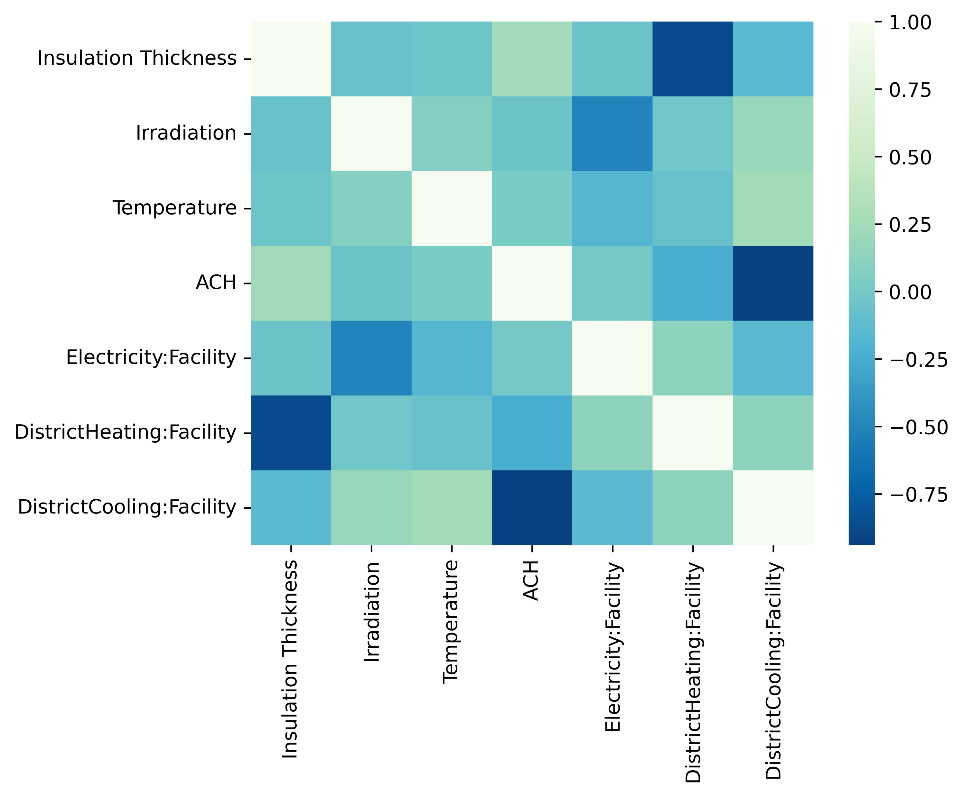
Relationships between building parameters and energy consumptions
Insulation Thickness:
Heating Demand: Strongly negative correlation; enhances thermal resistance.
Cooling/Electricity Demand: Minimal to slight increase due to trapped heat.
Irradiation:
Electricity Demand: Strongly negative; less need for artificial lighting.
Cooling Demand: Increases with more sunlight, complicating energy management.
ACH (Air Changes per Hour):
Cooling Demand: Negative correlation; more air changes reduce mechanical cooling needs.
Trade-off: Excessive ACH can increase energy consumption by removing conditioned air.
Seasonal Demand Variations:
Inverse Relationship: Heating increases in colder months, cooling in warmer months; crucial for adaptive energy management strategies.
11

Slide 12
Design Optimization
Optimize Parameters:
Insulation Thickness | Irradiation | Temperature | ACH
0.347823 | 81.923858 | 19.256269 | 5.597644
Objective Parameters:
Electricity [J] | DistrictHeating [J] | DistrictCooling [J] | Total [J]
1.404403e+10 | 1.430754e+10 | 1.163074e+10 | 3.998231e+10
MAE values for the problem objectives:
Electricity:Facility | DistrictHeating:Facility | DistrictCooling:Facility
0.000059 | 1.264588 | 0.460608
12

Slide 13
3
Data Dashboard
13

Slide 14
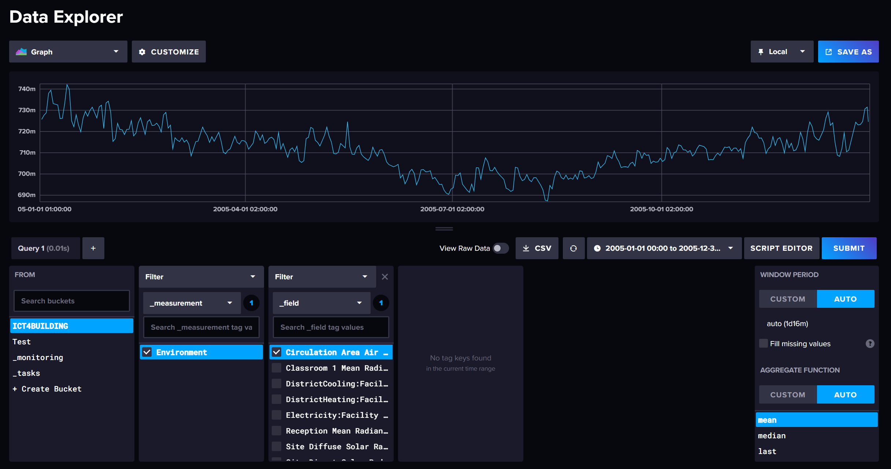
Simulation and Data Visualization
Stepped Simulation with I/O in EnergyPlus GYM
Real-time interaction and data exchange
Optimized IDF and EPW files for parameter.
Building Management System Framework
Data collection via sensors
Using MQTT protocol for data transmission.
14

Slide 15
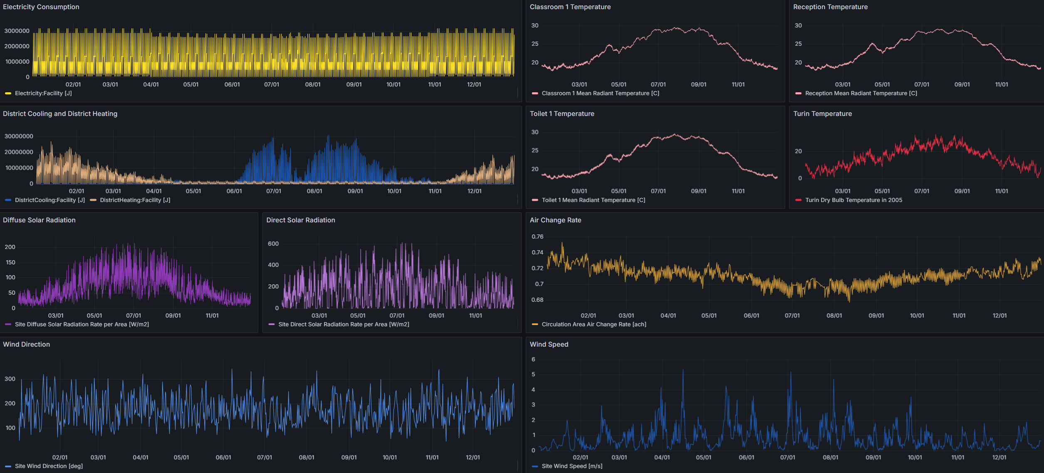
Grafana Dashboard
15

Slide 16
4
Energy Signature
16

Slide 17


Energy Signature
Energy signature represents the energy behavior of a building by correlating energy consumption with climatic variables.
Figure parameters
Power [Kw] vs $∆$T
Its diagram is a widely used instrument for analysis and prediction of energy use in the buildings.
Analysis method
OLS
(Ordinary Least Square)
17

Slide 18
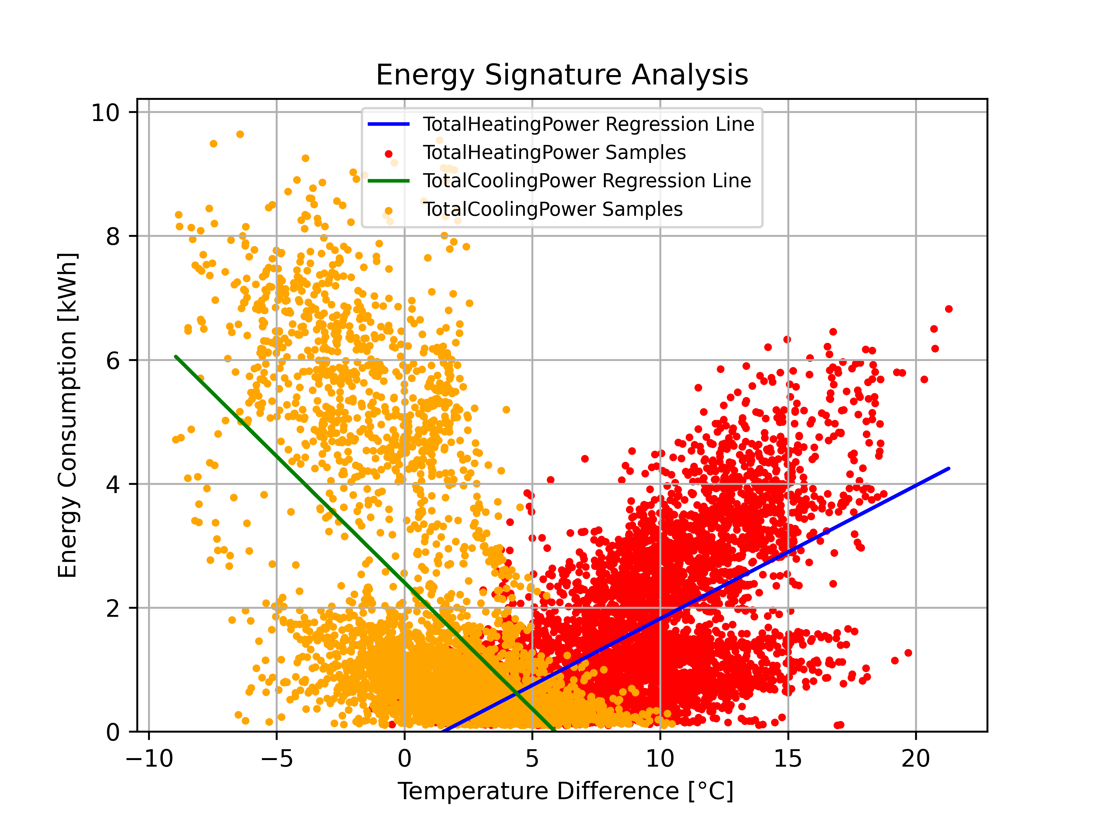
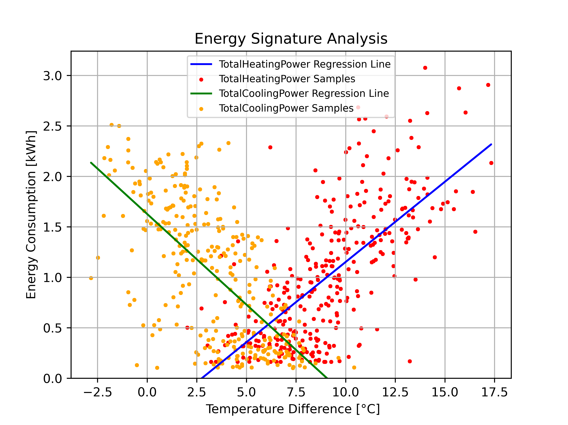
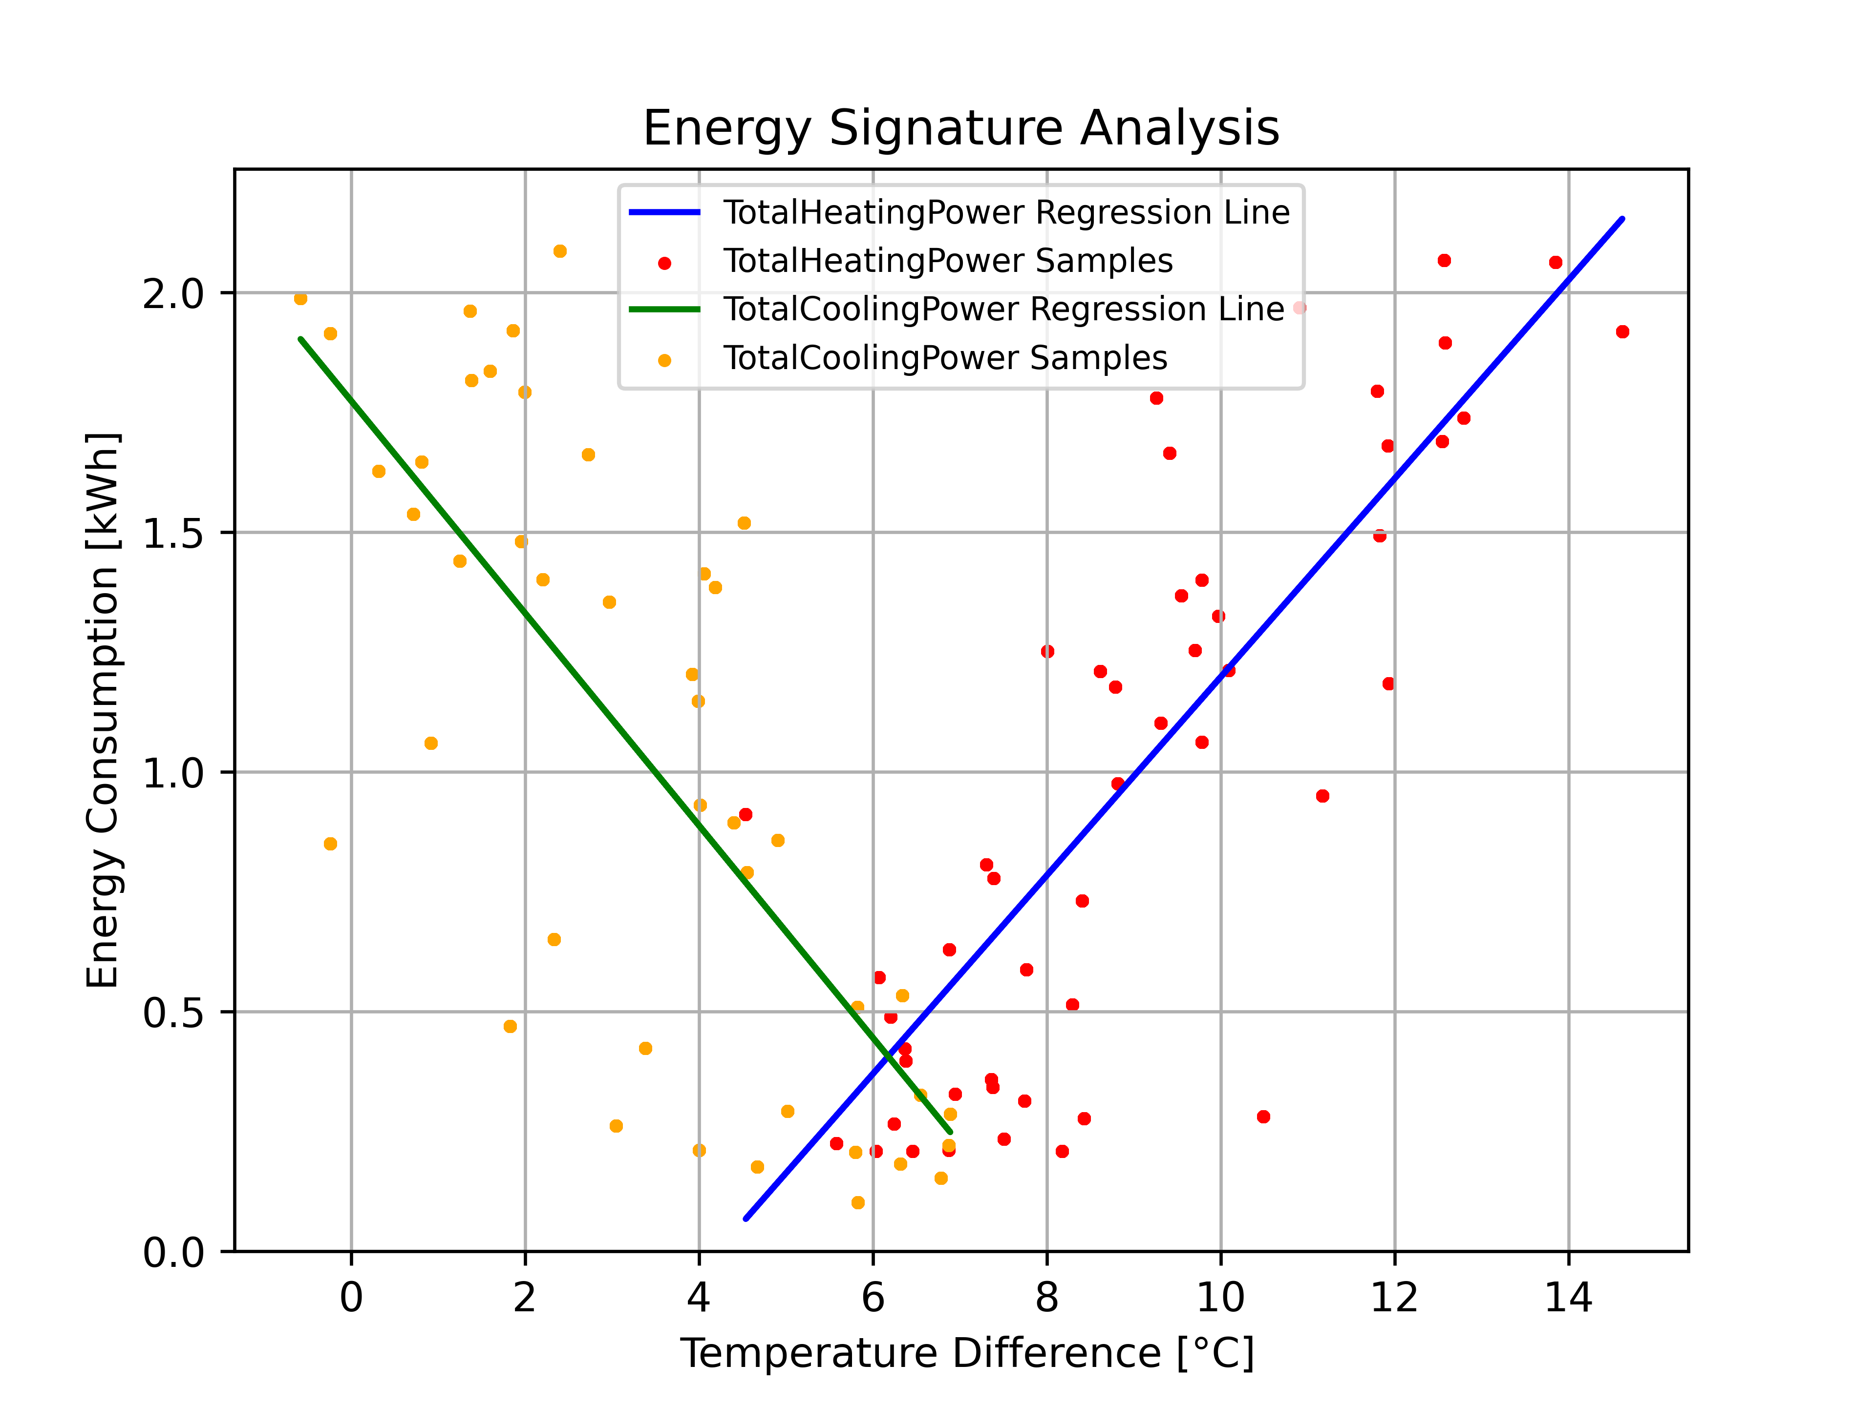
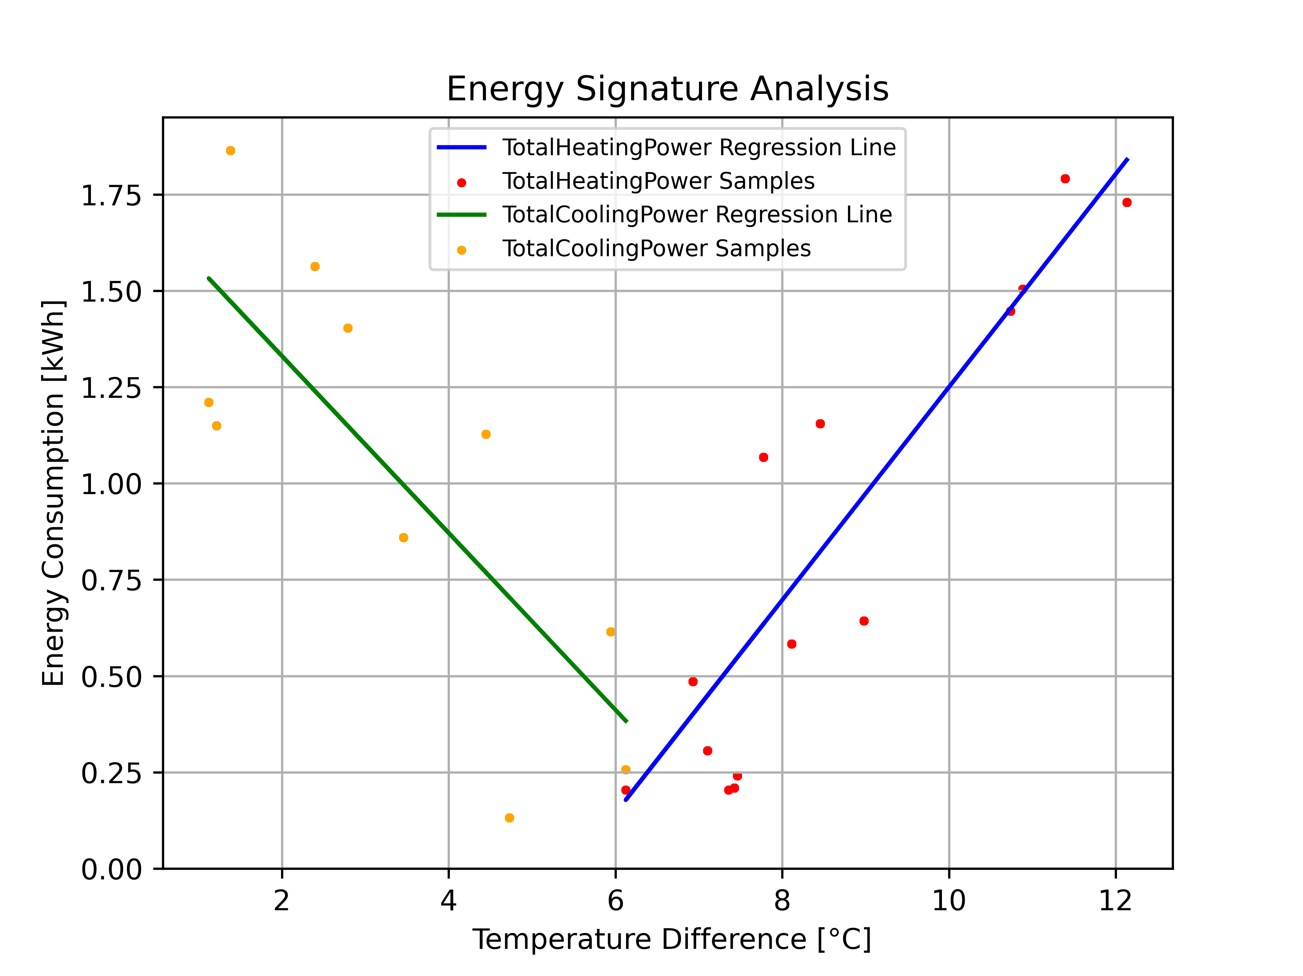
Energy Signature for Summer and Winter
18

Slide 19
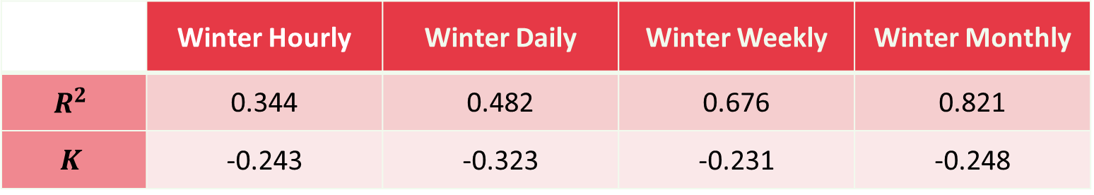
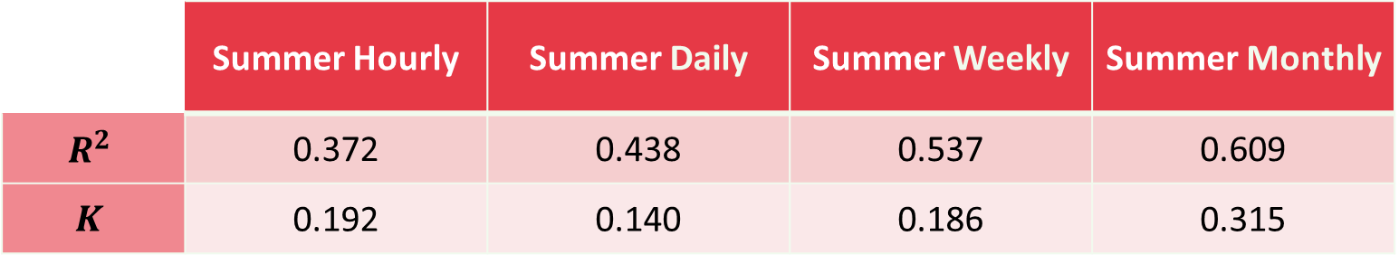
Energy Signature / R-squared for Regression
 | Winter Hourly | Winter Daily | Winter Weekly | Winter Monthly
$$R^{2}$$ | 0.344 | 0.482 | 0.676 | 0.821
$$K$$ | -0.243 | -0.323 | -0.231 | -0.248
 | Summer Hourly | Summer Daily | Summer Weekly | Summer Monthly
$$R^{2}$$ | 0.372 | 0.438 | 0.537 | 0.609
$$K$$ | 0.192 | 0.140 | 0.186 | 0.315
19

Slide 20
5
Prediction
20

Slide 21
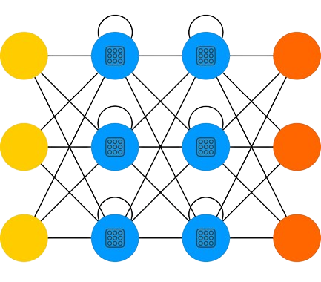

Prediction
LSTM (Long Short-Term Memory)
Type: Advanced Recurrent Neural Network (RNN) architecture.
Purpose: Specifically designed for effective modeling of sequential data.
Handles time series and other sequential data.
Incorporates memory cells to maintain and update information over time.
Overcomes vanishing gradient problems, improving learning stability and performance.
Captures long-term dependencies to enhance training accuracy.
21

Slide 22
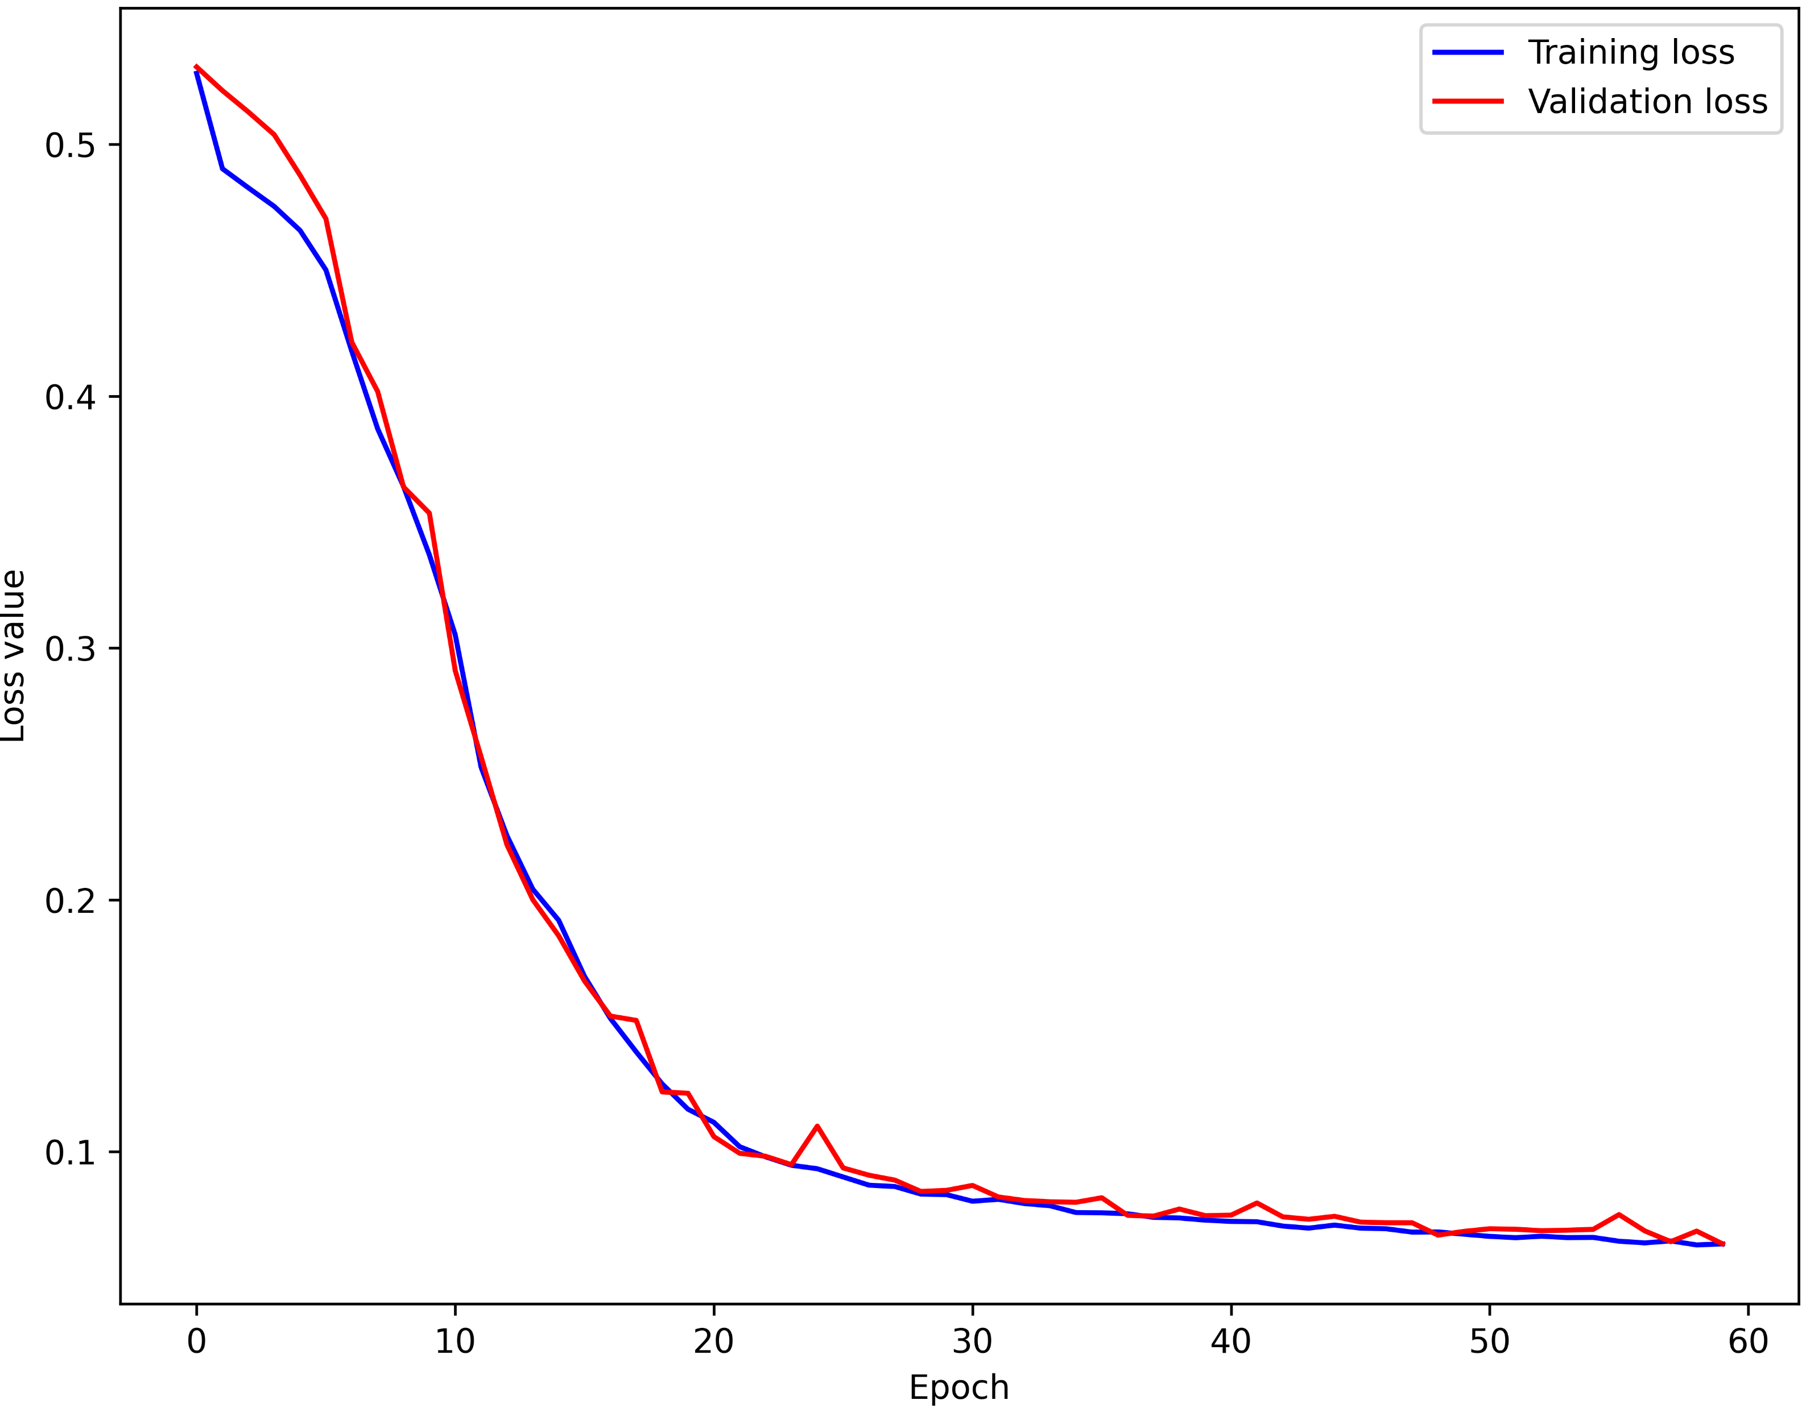
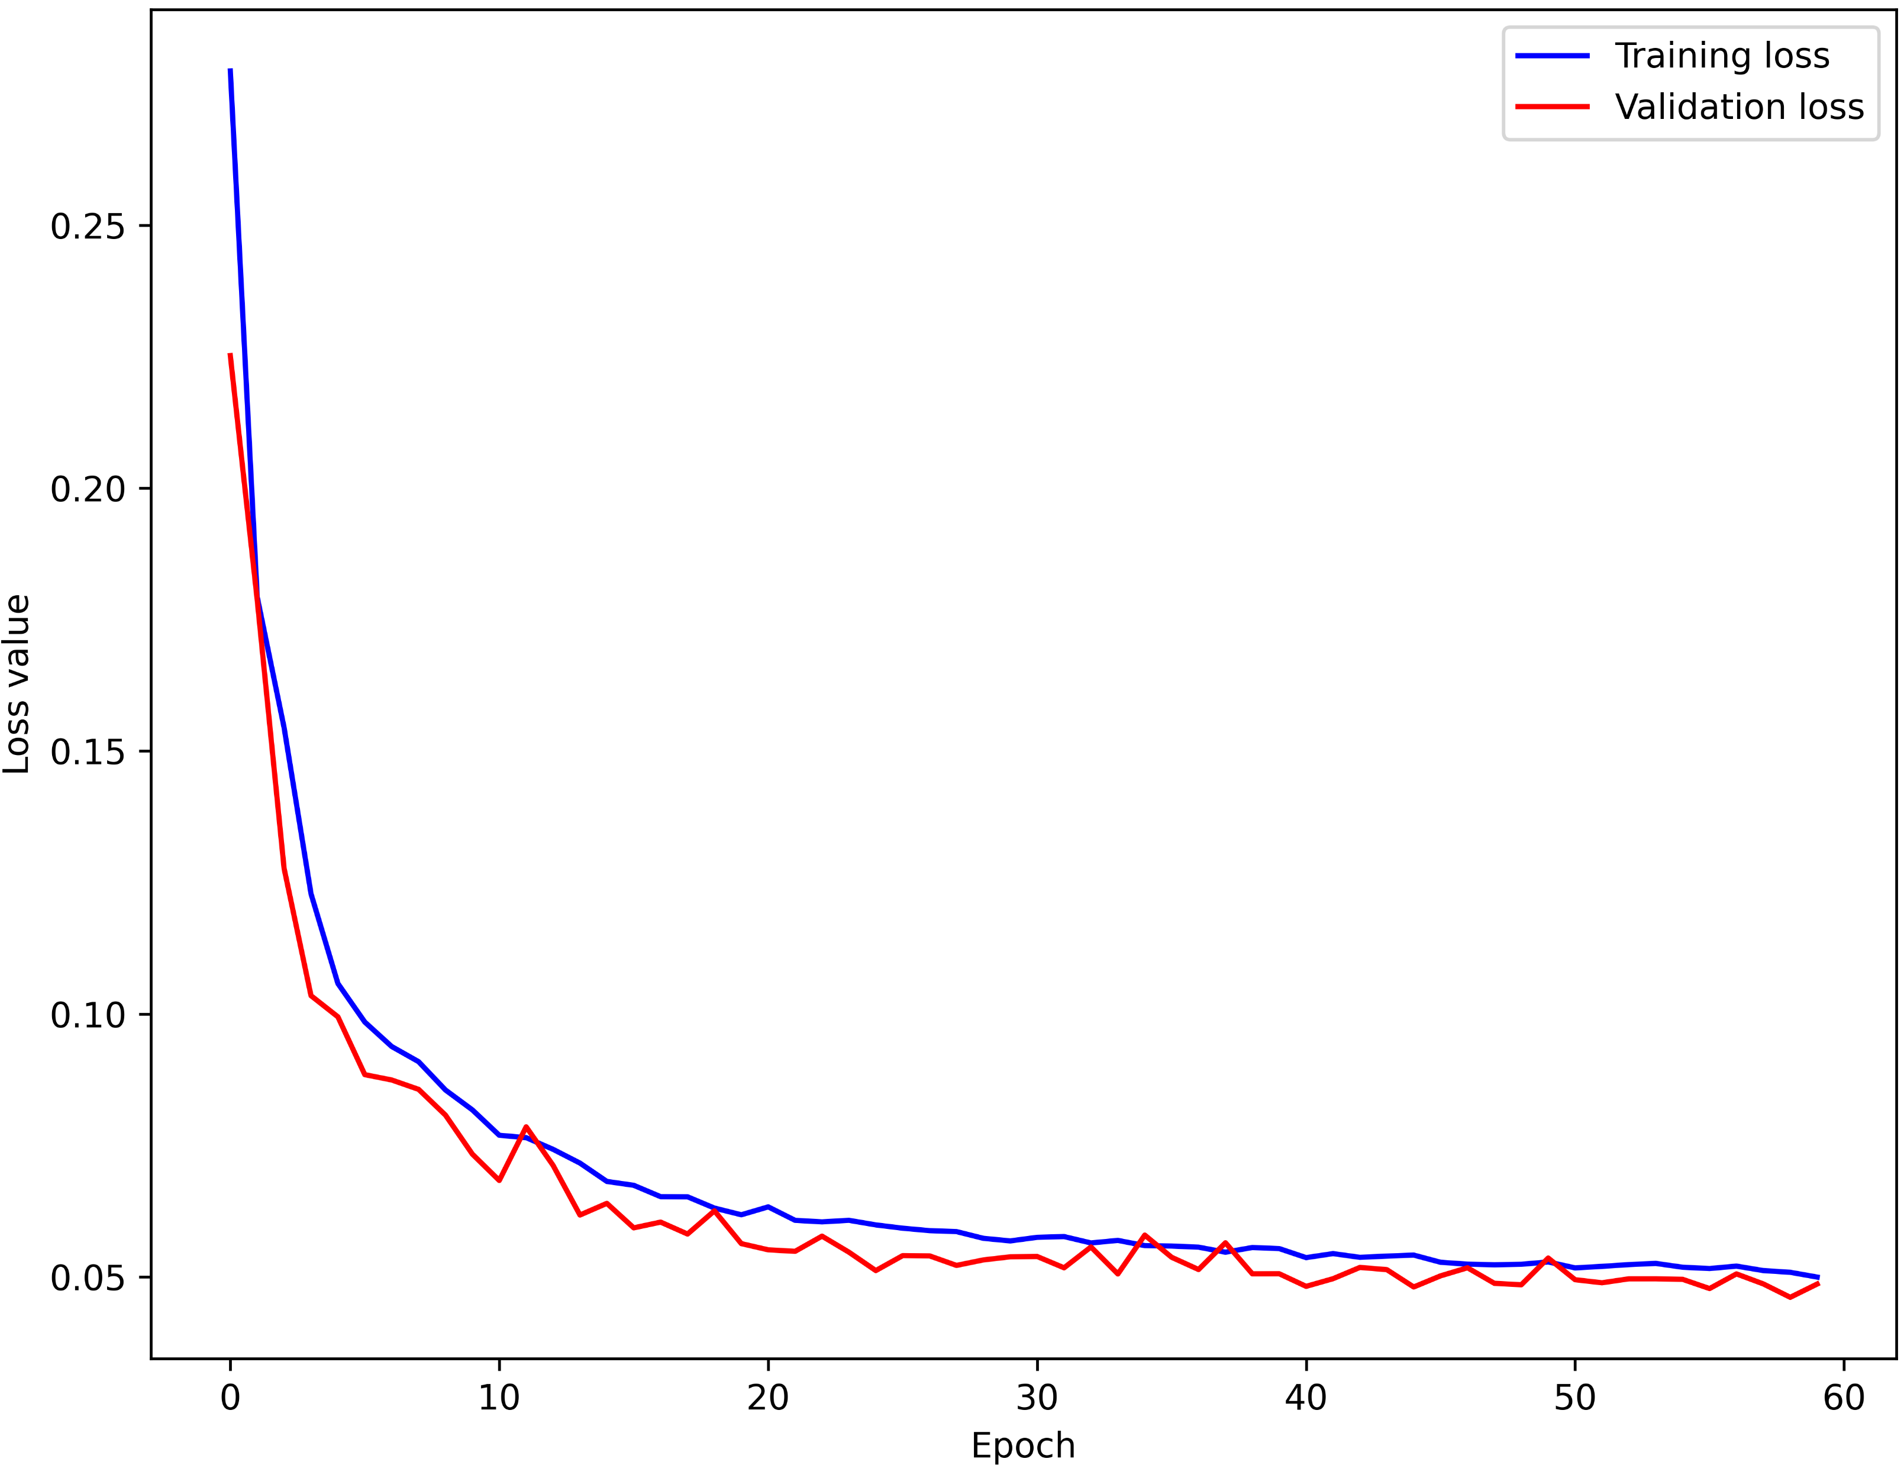
Validation and Training losses for Heating and Cooling consumptions
Lags | Step ahead | Epochs | Batch size | RMSE | MAE
72 | 3 | 60 | 32 | 2.76e+06 | 1.58e+06
72 | 3 | 60 | 32 | 3.94e+06 | 1.76e+06
72 | 3 | 60 | 64 | 1.24e+06 | 0.88e+06
72 | 3 | 60 | 64 | 2.82e+06 | 1.35e+06
Lags | Step ahead | Epochs | Batch size | RMSE | MAE
72 | 3 | 50 | 32 | 1.52e+06 | 1.52e+06
72 | 3 | 50 | 32 | 1.94e+06 | 0.66e+06
72 | 3 | 60 | 64 | 1.34e+06 | 0.54e+06
72 | 3 | 60 | 64 | 1.86e+06 | 0.78e+06
Heating
Cooling
22

Slide 23
Cooling and Heating consumption prediction with monthly view
23

Slide 24

Do you have any questions?

